Slide 1

SENSOR LOCALISATION TECHNIQUE IN IOT
Department of Computer Science & Engineering
Dibrugarh University Institute of Engineering & Technology
GROUP – 8
Arunangshu Chetia(CSE-04/20), Nityananda Basumatary(CSE-23/20),
Saddam Hussain Shah(CSE-31/20),Panchali Buzar Baruah(CSE-80/20)
Supervisied by - Dr. Sudipta Majumder
Dated: 28th May,2024

Slide 2
Table of Content
Introduction
Objective
Methodology
Experiment
Interpretation of Result
Limitation
Summary
Contribution
Future work

Slide 3
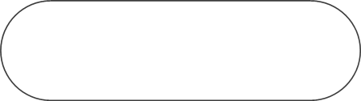
01
Introduction
IPS is crucial where GPS fails indoors due to obstacles, multipath propagation, and dynamic layouts. With smart buildings, IoT, and location-based services, precise indoor positioning is essential for:
Navigation in airports, malls, hospitals
Asset tracking in warehouses, factories
Enhancing user experiences in museums, exhibitions
Bluetooth, RFID, UWB, and Wi-Fi are used, with Wi-Fi being prominent due to widespread infrastructure.
Wi-Fi Fingerprinting: Collects signal strength data to estimate positions but faces challenges like signal variability and interference.

Slide 4
02
Objective
The aims to address the limitations of traditional Wi-Fi fingerprinting techniques by leveraging the capabilities of Recurrent Neural Networks (RNNs). The primary objectives of this research are:
To develop a simple RNN model that can effectively process Wi-Fi signal strength data for indoor positioning.
• To evaluate the performance of the RNN model in terms of accuracy and distance model, comparing it with traditional baseline models such as k nearest neighbors(KNN), and support vector machines (SVM).
• To identify key factors that influence the accuracy of indoor positioning using RNNs, including preprocessing steps, feature selection, and model hyper parameters

Slide 5
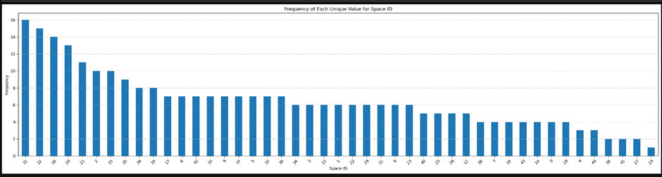
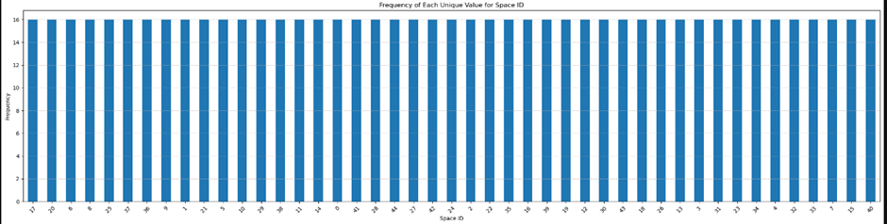
03
Methodology
The UJIIndoorLoc dataset contains extensive Wi-Fi signal strength data for indoor positioning research, comprising over 20,000 samples across three buildings, multiple floors, and various locations, with each sample including RSSI values, location info, and timestamp, divided into training and validation sets.
Preprocessing
Handling Missing Values : Replace RSSI values of 100 dBm with lower bound (-105 dBm) or interpolate based on nearby measurements.
Normalization : Normalize RSSI values using Min-Max Scaling or Standardization.
Figure 2 : Frequency of Unique Space Id before Normalization
Figure 3 : Frequency of Unique space id After Normalization

Slide 6
04
Feature Selection
Remove access points with weak signals or high variability.
Select access points with stable and distinct RSSI values.
Data Augmentation: Introduce variations in RSSI values or simulate different user movements.
Model Selection
Recurrent Neural Network (RNN)
Capture temporal dependencies.
Input Layer: Wi-Fi signal strengths.
Hidden Layers: Simple RNN architecture.
Output Layer: Predicted location coordinates or classification labels.
.

Slide 7
05
Training and Validation
Data Splitting : Split dataset into training and validation sets.
Loss Function : MSE for regression, categorical cross-entropy for classification.
Optimization : Train with backpropagation through time (BPTT) using algorithms like Adam or RMSprop.
Hyperparameter Tuning: Tune hyperparameters using cross-validation.
Evaluation
Distance Error: Measure Euclidean distance between predicted and actual coordinates.
Accuracy : Report percentage of predictions within specific distance thresholds.
Precision and Recall: Calculate for classification tasks.
F1-Score: Combine precision and recall for balanced measure.
Baseline Models
K-Nearest Neighbors (KNN): Assign location based on majority vote of k-nearest neighbors.
Support Vector Machines (SVM) : Construct hyperplane to separate classes or predict coordinates.

Slide 8
06
Implementation Details
Environment: Conduct experiments on standard hardware and software.
Code Structure: Organize codebase into modules for reproducibility.
Hyperparameter Optimization: Use grid search and randomized search.
Cross-Validation
K-Fold Cross-Validation :Divide dataset into k subsets for training and validation.
Leave-One-Out Cross-Validation (LOOCV) :Use each sample as a validation instance.

Slide 9
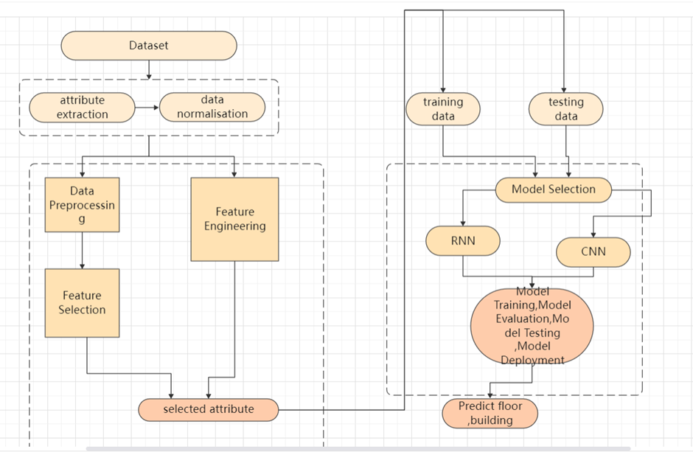
07
Figure 4 : Model Flowchart

Slide 10
09
Experiment
Baseline Model
K-Nearest Neighbors (KNN) and Support Vector Machines (SVM) were used as baseline models to benchmark performance:
KNN: Tested various values of k to find the optimal setting.
SVM: Evaluated different kernels (linear, polynomial, RBF) and regularization parameters.

Slide 11
10
RNN Model Training
A simple Recurrent Neural Network (RNN) was trained using the UJIIndoorLoc dataset:
Architecture: Basic RNN with input, hidden, and output layers.
Hyper parameters: Optimized learning rate, batch size, and number of epochs through cross-validation.
Training: Used backpropagation through time (BPTT) with the Adam optimizer.
Performance Evaluation
The RNN model's performance was evaluated against the baseline models using several metrics:
Distance Error: Mean, median, and standard deviation of the Euclidean distance between predicted and actual coordinates.
Accuracy: Percentage of predictions within 1 meter, 3 meters, and 5 meters.
Precision and Recall: For building and floor classification tasks.
F1-Score: Balanced measure of precision and recall.
Comparative Analysis
The RNN model was compared to the baseline models:
Distance Error: RNN showed lower mean and median distance errors.
Accuracy: Higher accuracy within 1 meter, 3 meters, and 5 meters.
Precision and Recall: Improved for building and floor classification.
F1-Score: Better overall performance in classification tasks.

Slide 12
11
Interpretation of Results
The Recurrent Neural Network (RNN) significantly outperforms traditional models like K-Nearest Neighbors (KNN) and Support Vector Machines (SVM) for indoor positioning using Wi-Fi signal data. Key findings include:
Enhanced accuracy and precision, crucial for precise applications like indoor navigation.
Higher accuracy within small distance thresholds, beneficial for exact localization tasks.
Improved metrics for building and floor identification, vital for multi-floor navigation.
Consistent performance across validation sets, demonstrating robustness and generalization.
Stable estimates despite Wi-Fi signal variability, offering reliable location estimates.

Slide 13
12
Limitation
Inherent Wi-Fi Signal Variability: Wi-Fi signals are influenced by factors such as physical obstructions, interference, and environmental changes, leading to unpredictability that affects positioning accuracy.
Sparse Access Point Coverage: Reliance on Wi-Fi signals alone may be insufficient in environments with sparse access points or highly dynamic conditions.
Need for Additional Sensor Data: Integrating data from accelerometers and gyroscopes could enhance the model's robustness and mitigate issues related to signal variability and sparse coverage.
Computational Complexity: RNNs have high computational complexity and training time, posing challenges for real-time applications, especially on resource-constrained devices.
Optimization and Integration: Further research is needed to optimize RNN models for faster inference and explore their integration with other sensor modalities for improved accuracy and reliability.

Slide 14
13
Summary
Enhanced Positioning Accuracy: The RNN model significantly reduces mean and median distance errors compared to K-Nearest Neighbors (KNN) and Support Vector Machines (SVM).
Superior Accuracy Within Distance Thresholds: RNN achieves higher accuracy within 1, 3, and 5 meters, crucial for precise applications like indoor navigation and asset tracking.
Improved Classification Performance: RNN outperforms KNN and SVM in identifying the correct building and floor, with better precision, recall, and F1-scores.
Robustness and Generalization: RNN demonstrates consistent performance across different validation sets, showing strong generalization to new data.
Effective Handling of Wi-Fi Signal Variability: RNN adapts well to signal fluctuations, providing more stable and reliable positioning estimates than traditional models.

Slide 15
14
Contribution
RNNs for Indoor Positioning: Demonstrates RNNs' effectiveness in improving accuracy, outperforming KNN and SVM by capturing temporal dependencies in Wi-Fi data.
Enhanced Accuracy: RNNs achieve lower distance errors and higher accuracy within small thresholds, crucial for precise applications like indoor navigation and asset tracking.
Improved Classification: RNNs excel in identifying the correct building and floor, showing better precision, recall, and F1-scores than traditional models, essential for multi-floor navigation.
Robustness and Generalization: RNNs consistently perform well across different validation sets, suitable for real-world deployment with varying environmental conditions.
Handling Wi-Fi Variability: RNNs effectively manage Wi-Fi signal fluctuations, providing more stable and reliable positioning estimates than traditional methods.

Slide 16
15
Future Work
Integrating Additional Sensor Data: Combining Wi-Fi signals with data from accelerometers, gyroscopes, and magnetometers to improve accuracy.
Exploring Advanced Neural Networks: Using more sophisticated models like Long Short-Term Memory (LSTM) and Gated Recurrent Units (GRUs) to better handle long-term dependencies.
Optimizing for Real-Time Applications: Enhancing computational efficiency to enable real-time positioning on smartphones and IoT devices.
Adapting to Diverse Environments: Testing models in varied indoor settings and developing strategies for rapid adaptation to new environments.
Combining with Other Localization Techniques: Creating hybrid solutions by integrating RNN-based systems with Bluetooth beacons, ultra-wideband (UWB), or visual SLAM.
Modeling User Behavior: Incorporating user movement patterns to refine position estimates in complex indoor environments.
These directions aim to further advance the capabilities and applications of indoor positioning systems.

Slide 17
Thank you!

